Slide 1
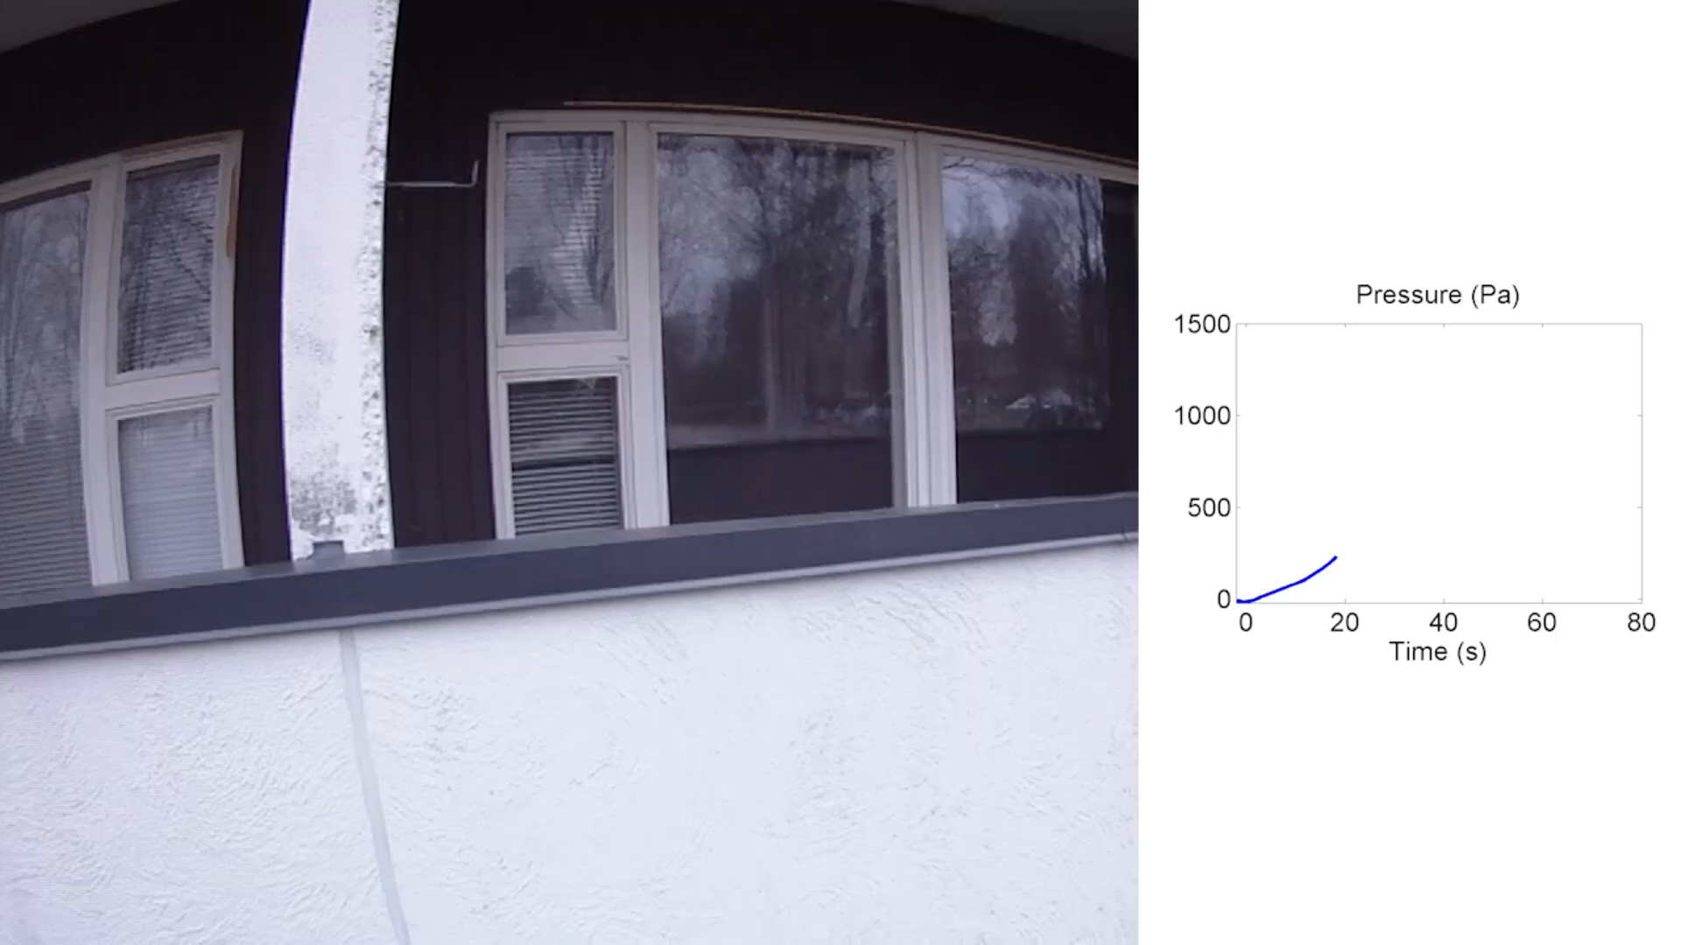
PUF in closet, normal ventilation

Slide 2
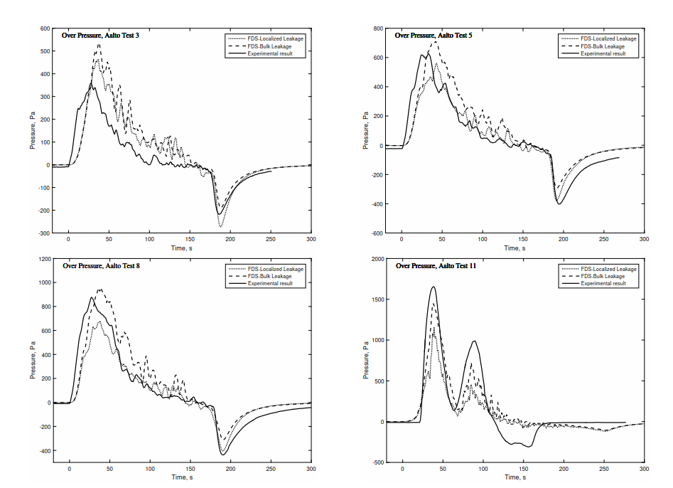
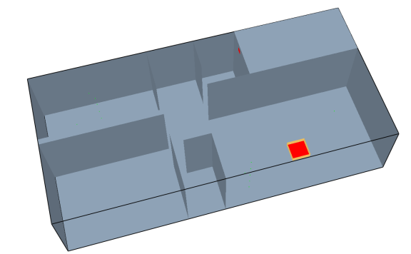
Validation of FDS modelling
Prescribed HRR
Simple HVAC
Local / bulk leakage

Slide 3
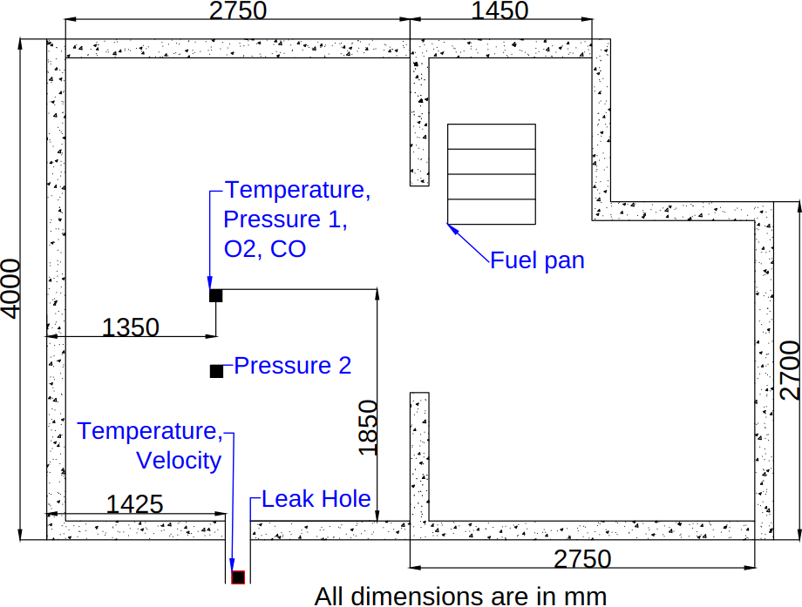
Additional validation data
FOA experiments by Hägglund et al. 1996 and 1998.
Heptane pool fires in concrete enclosure.
No HRR measurement.

Slide 4
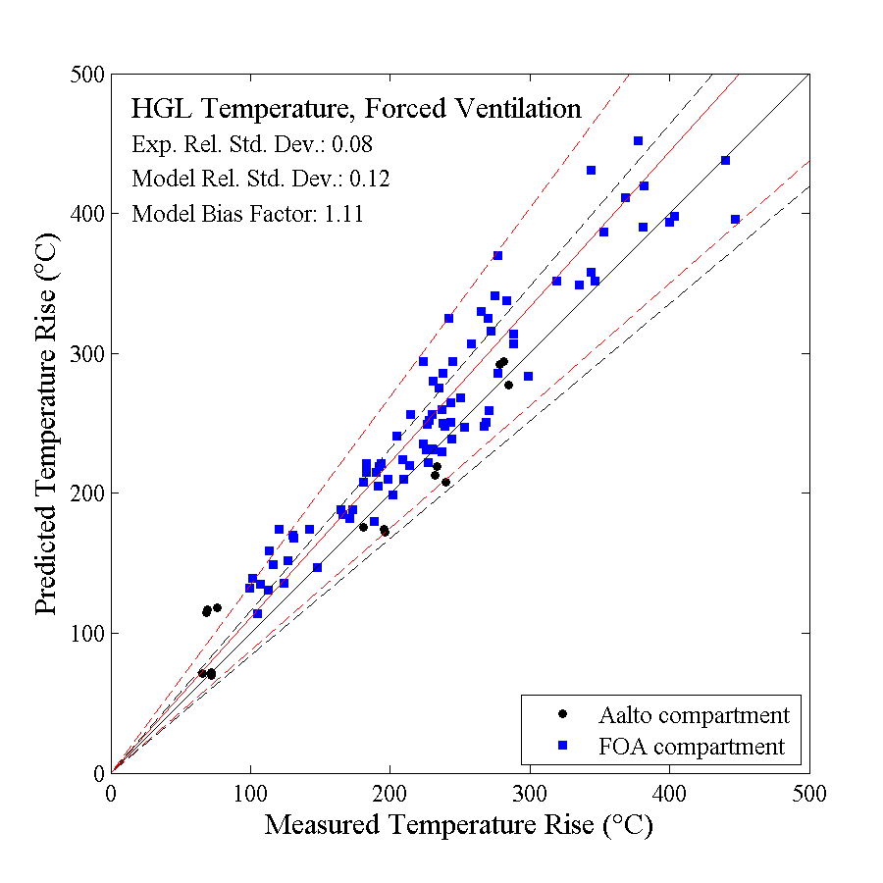
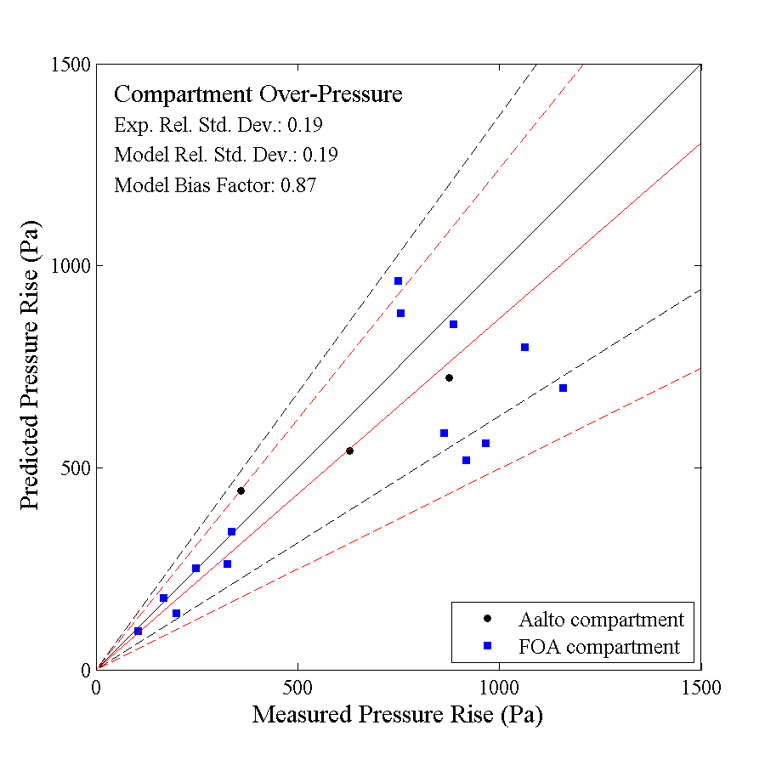
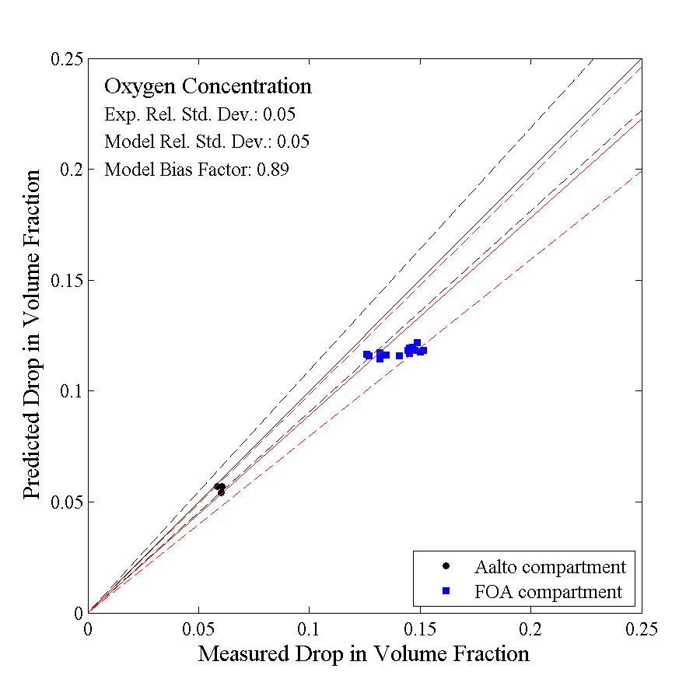
Summary

Slide 5
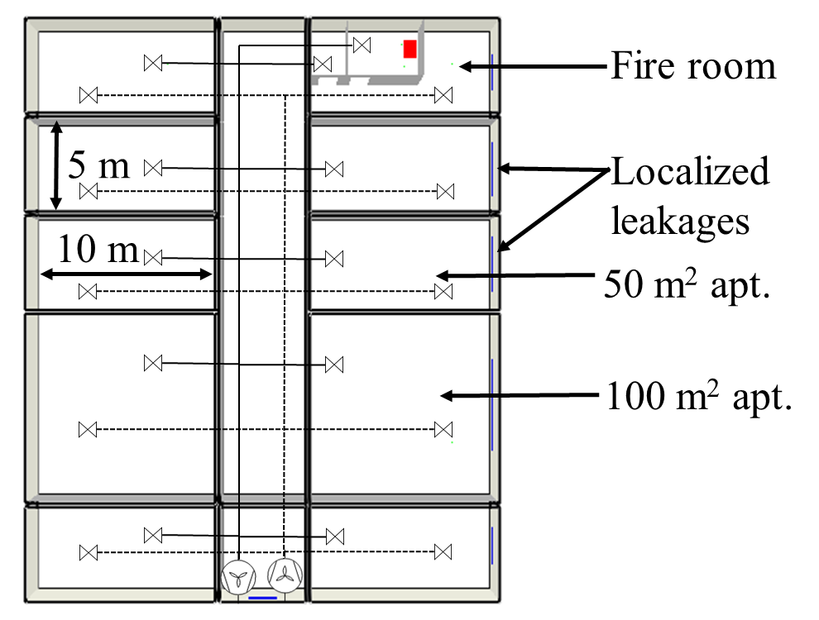
Apartment case study
Three air-tightness levels
Traditional: q50 = 3.0 m³/m²h
Normal: q50 = 1.5 m³/m²h
Near-zero: q50 = 0.75 m³/m²h
HRR: t²-fires medium – ultra-fast
Damper configurations:
No dampers
Only inlet branch closed
Both inlet and outlet closed
Fan configurations
On
Off and open
Off and outside damper closed

Slide 6
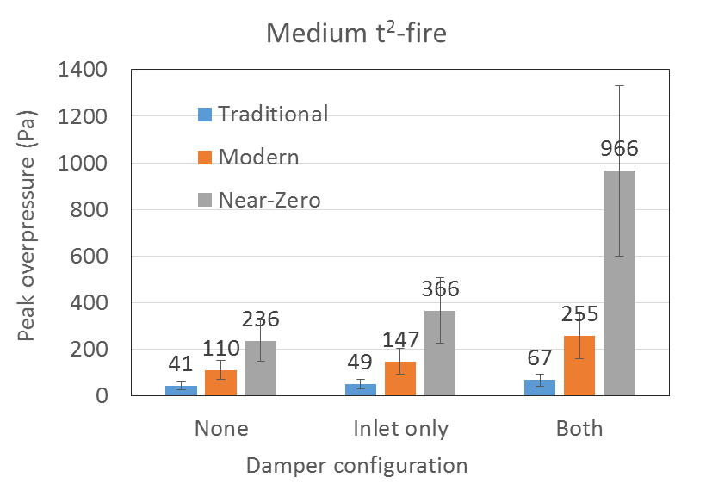
Peak pressures with medium fire

Slide 7
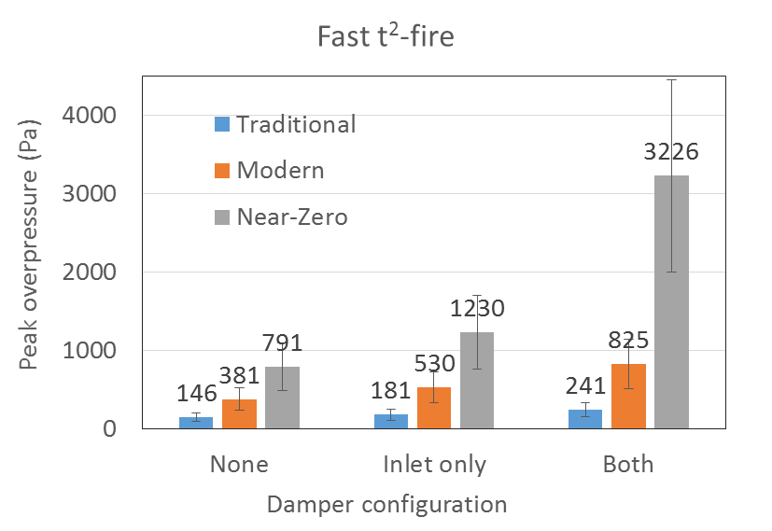
Peak pressures with fast fires

Slide 8
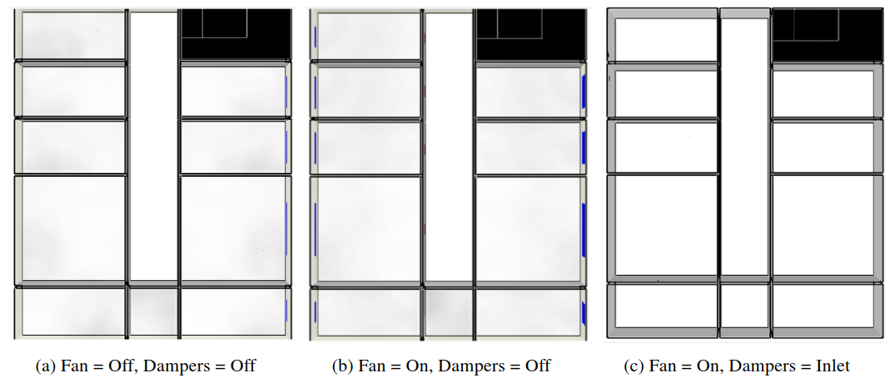
Smoke spreading to neighbours

Slide 9
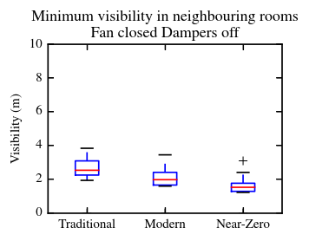
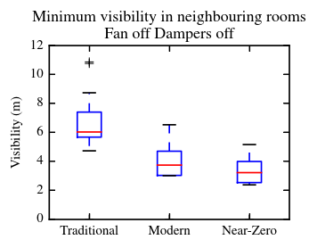
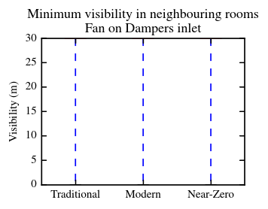
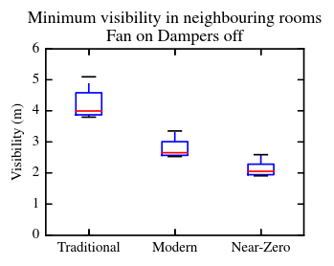
Smoke spreading: visibility
NO SMOKE

Slide 10
Pressure management
1500 Pa threshold would require 0.002 m² (D = 50 mm) total leak area.
100 Pa would require 0.0425 m² (D = 230 mm)
leak area.

Slide 11
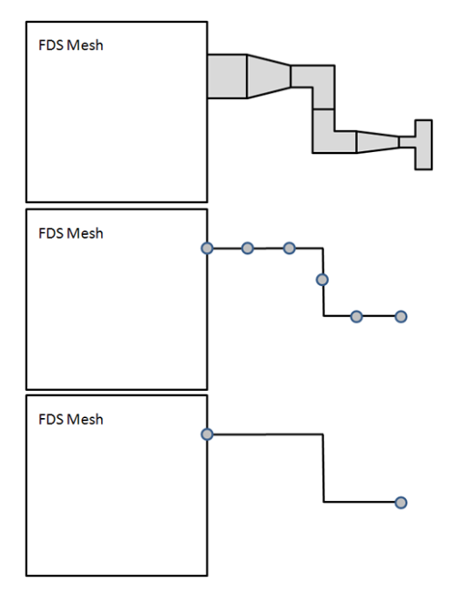
Issues with the HVAC system modelling
Real systems are too complex for ”engineering” the model.
Fan units are much more than just a fan. Pressure losses of the fan unit can dominate.
Real systems are always tuned and balanced for normal mode of operation. We can do the same for the FDS model, but a better tool would help.

